Slide 1


Bank Loan Case Study
Prepared by : Shivam Singh
Email id: Shivamkumsingh@gmail.com

Slide 2

Contents
Project Description
Approach
Tech-Stack Used
Data Analytics Task & Insights
Result and Conclusion

Slide 3


Project Description
In this project, I applied Risk Analytics to bank loan data by performing Exploratory Data Analysis (EDA) to understand how consumer attributes influence the likelihood of loan default.
Through EDA, I identified key patterns and strong indicators driving defaults. The project involved managing missing data, detecting outliers, addressing data imbalance, and conducting univariate, segmented univariate, and bivariate analyses. I also examined correlations to differentiate clients with payment difficulties from other customer groups.

Slide 4

Approach
Data Extraction: Downloaded and Imported the dataset into Excel.
Data Cleaning: Cleaned the data by removing blanks/null or imputing them, removing invalid entries and addressing any outliers.
Analysis: Used Pivot Tables and charts to visualize trends and uncover key insights and analyzed the findings and compiled them into a report.

Slide 5



Tech-Stack Used
Microsoft Excel 2016: Used for data cleaning and visualizations. Excel provides powerful tools like charts, graphs, pivot tables, and various formatting options that make it easier to analyze and interpret data effectively.
Microsoft PowerPoint 2016 (PPT): Used for structuring and presenting insights.
Google Drive: Used for storing and sharing reports.

Slide 6

Data Analytics Task
The Dataset contains 50000 rows and 122 columns in all and consists of Missing values/Blanks/Null values and Outliers.
85 columns were used for analysis and the rest 37 Columns was removed due to irrelevant Columns.
Missing values were imputed by Median/Mode.
Missing percentage >60% were removed due to large dataset.
Using IQR Method, Outliers was found.
All the Insights are based on Sheet – “Application_data_Cleaned”
All the Charts are attached to respective tasks.
As Dataset is very large and not able to open directly in Google sheet, therefore link has been provided to download and view properly.
Click here for the Dataset

Slide 7
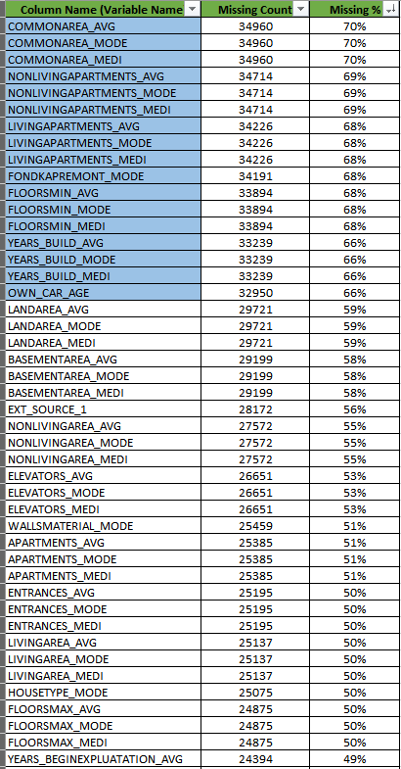
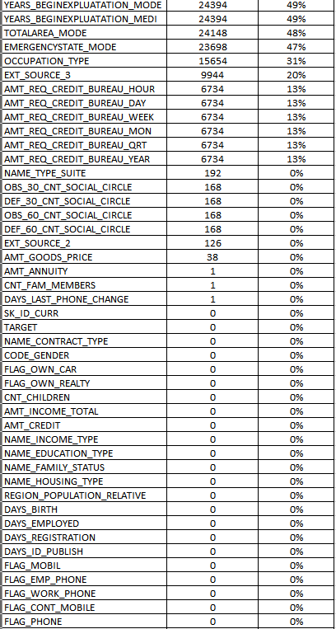
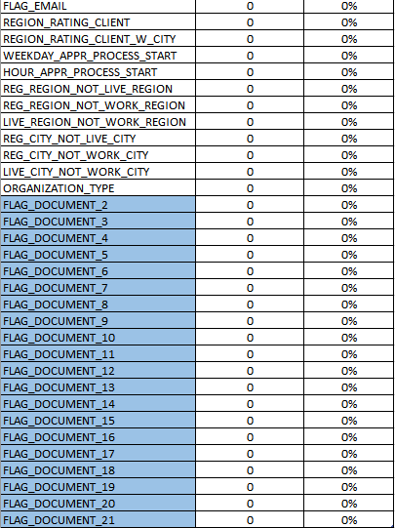
Insights
A. Identify Missing Data: Identify the missing data in the dataset and decide on an appropriate method to deal with it using Excel built-in functions and features.

Slide 8
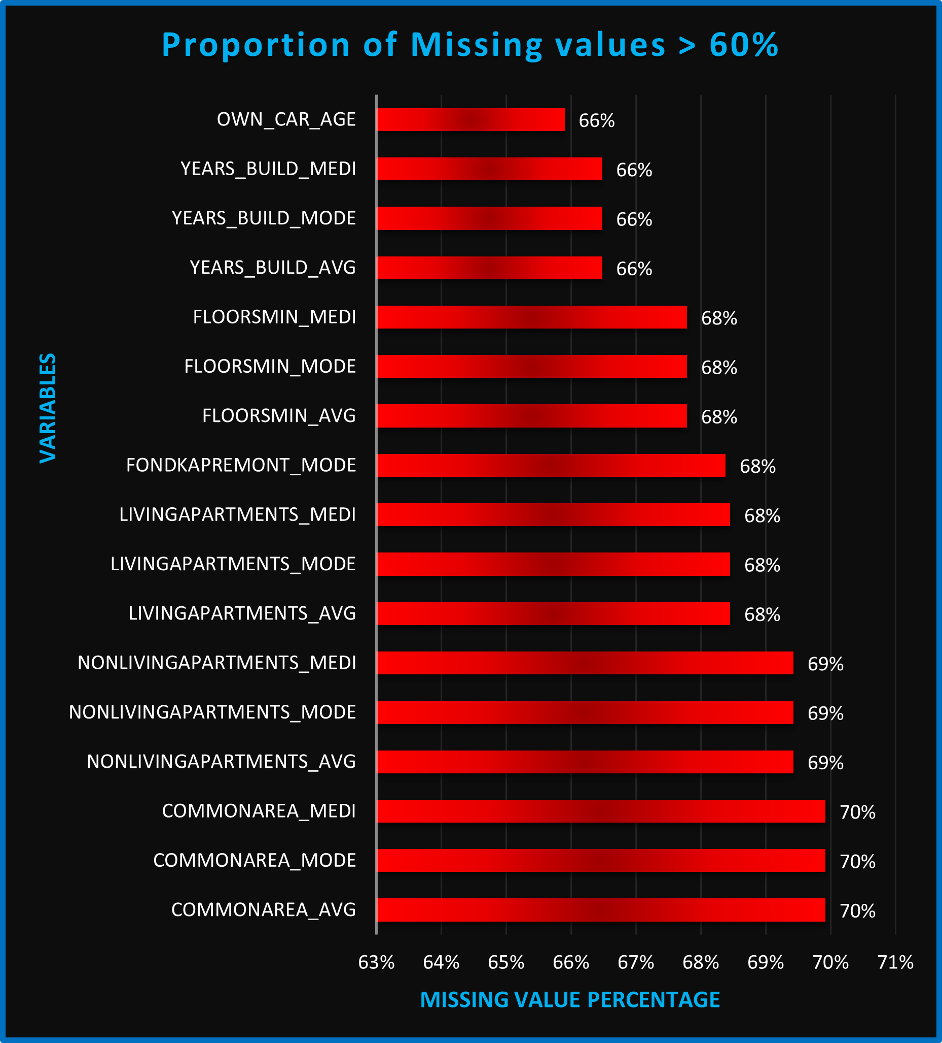
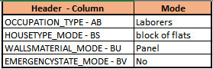
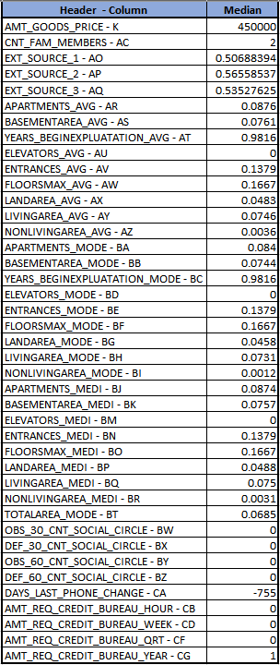
Categorical Variables
Column name highlighted with Blue are dropped from "application_data" sheet as of missing % > 60% and last FLAG_DOCUMENT_2 to FLAG_DOCUMENT_21 as irrelevant for analysis.
For Imputation of Missing Data:
* For Numeric Variables, MEDIAN OR AVERAGE Formula used.
* For Categorial Variables, MODE Formula used.
Numerical Variables

Slide 9
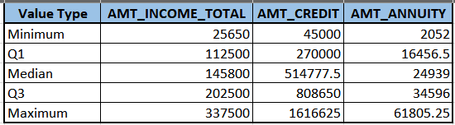
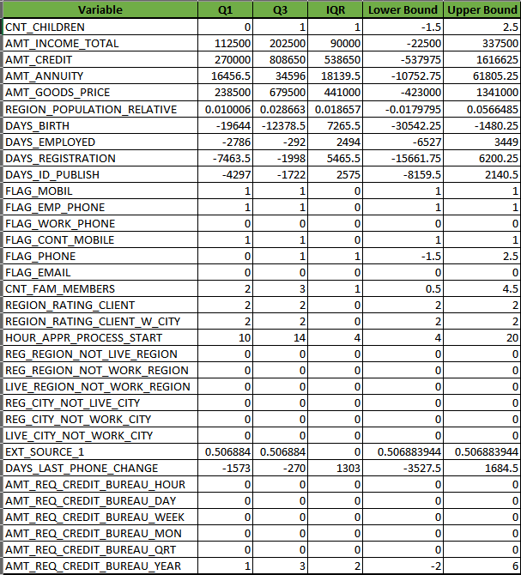
B. Identify Outliers in the Dataset: Detect and identify outliers in the dataset using Excel statistical functions and features, focusing on numerical variables.
Q1 and Q3 are calculated using formula: =PERCENTILE.INC(Application_data_Cleaned!H:H, 0.25) and =PERCENTILE.INC(Application_data_Cleaned!H:H, 0.75) respectively.
Minimum: Formula used: =MINIFS
IQR = Q3 - Q1

Slide 10
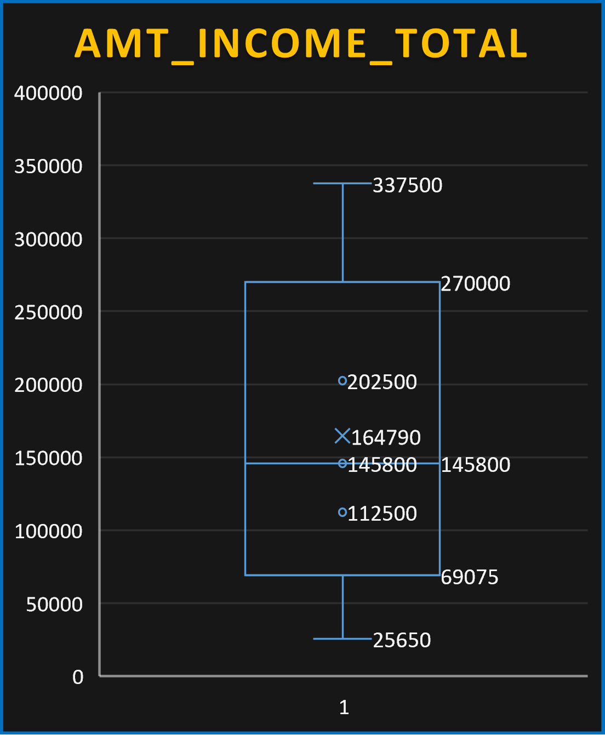
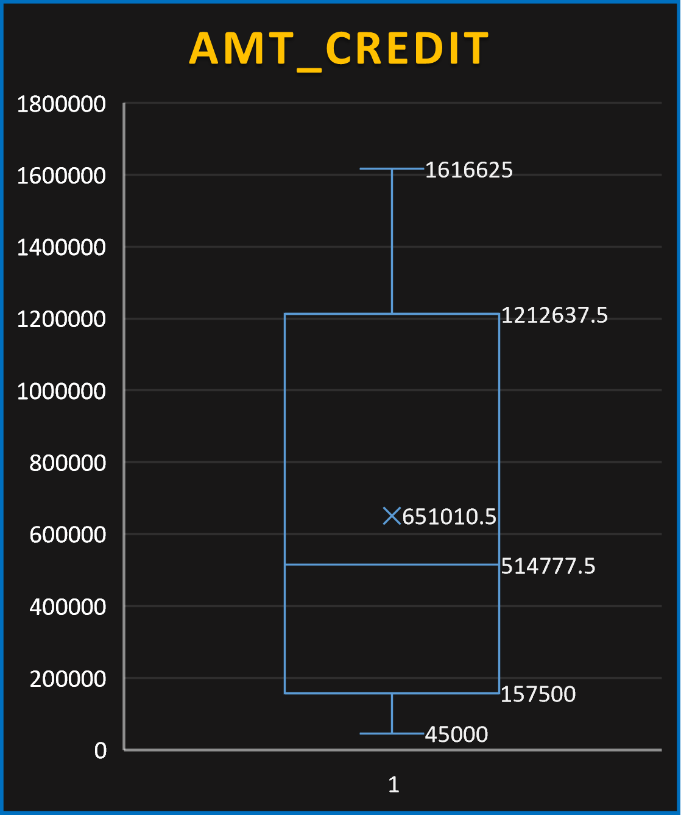
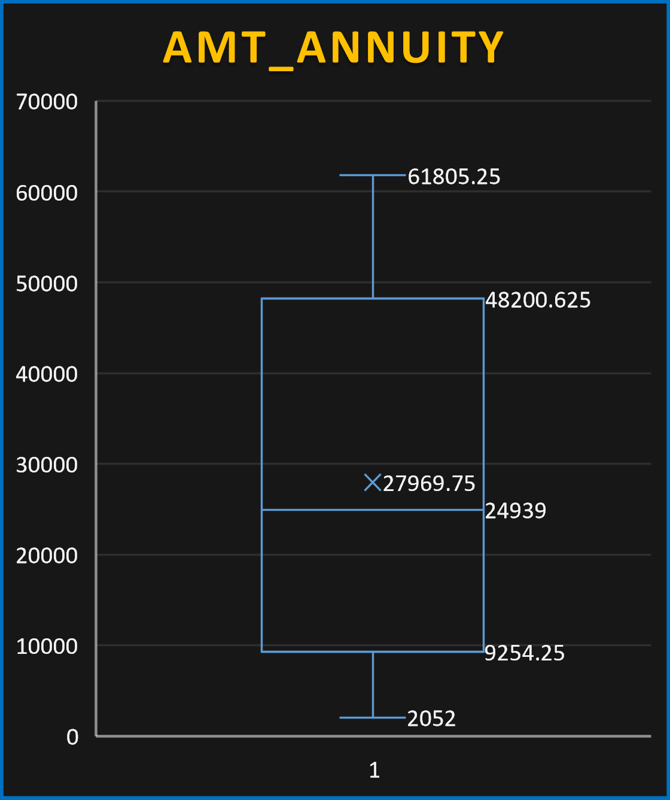

Slide 11
AMT_INCOME_TOTAL (Total Income):
Median: 145,800
Mean (X): 164,790 — greater than the median → shows right-skewed distribution
Upper bound (for outliers): 337,500
Outliers: Any values above 337,500
The income distribution is positively skewed, meaning a few applicants have very high income, pulling the mean higher than the median.
AMT_CREDIT (Credit Amount):
Median: 514777.5
Mean (X): 651010.5
Upper bound (for outliers): 1,616625
Outliers: Any values above 1,616625
The credit amounts are wide-ranging, with a few very large loans being clear outliers. This may be due to mortgage or business loans.
AMT_ANNUITY (Annuity Amount):
Median: ₹24939
Mean (X): ₹27969.75
Upper bound (for outliers): ₹61805.25
Outliers: Any values above ₹61805.25
Annuity values are more concentrated, but some applicants have very high annuities, which could indicate expensive loan terms or high-value loans.

Slide 12
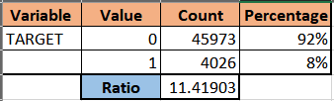
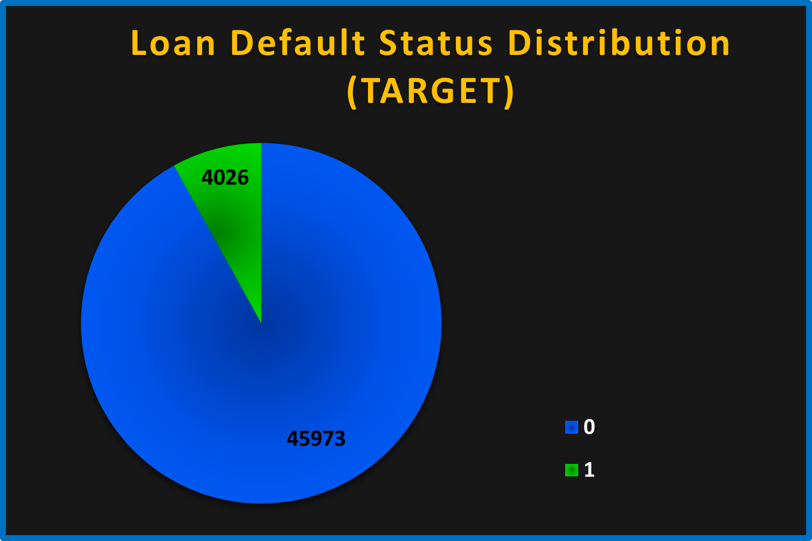
C. Analyze Data Imbalance: Determine if there is data imbalance in the loan application dataset and calculate the ratio of data imbalance using Excel functions.
Value Count
0 45,973 (Non-defaulters)
1 4,026 (Defaulters)
The dataset is highly imbalanced with only about 8 % of applicants being defaulters.
This imbalance can affect machine learning models by biasing them toward the majority class (non-defaulters).

Slide 13
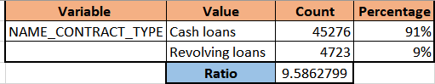
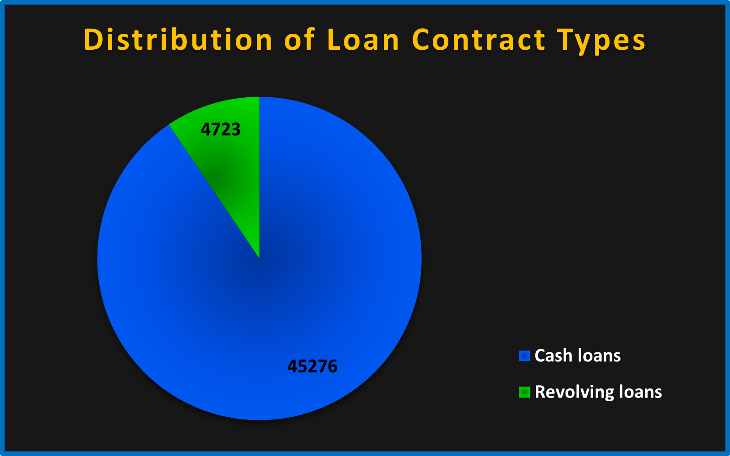
Contract Type Count
Cash loans Very High
Revolving loans Much Lower
Cash loans dominate the dataset.
Revolving loans are present but in much smaller numbers.

Slide 14
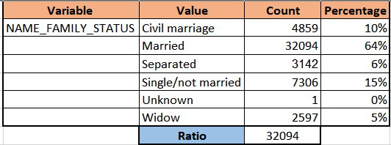
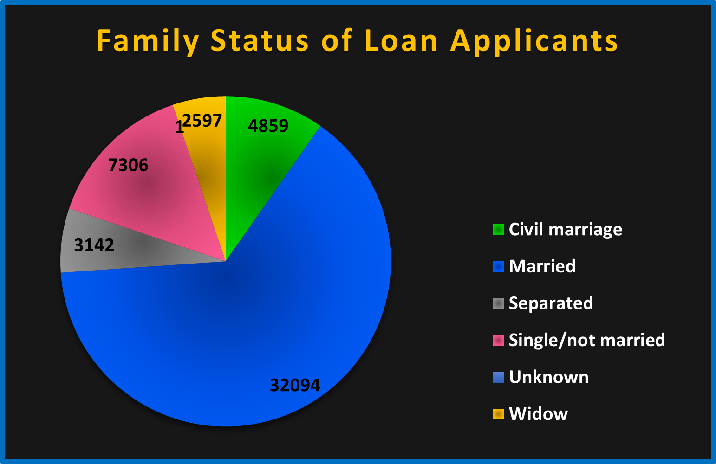
Status Count
Married Very High (32,094)
Civil marriage Medium (4859)
Single/not married High (7306)
Widow, Separated Low (2597)
Unknown 1
Married applicants make up the largest group by far.
Unknown is an outlier (only 1 record), which skews the ratio to 32,094.

Slide 15
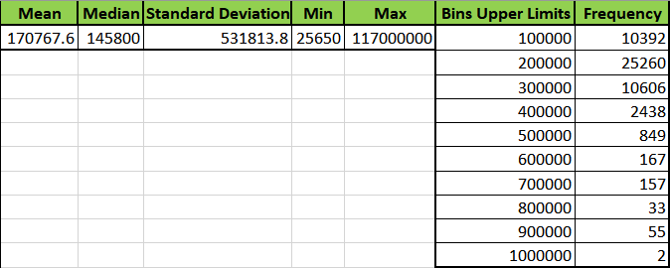
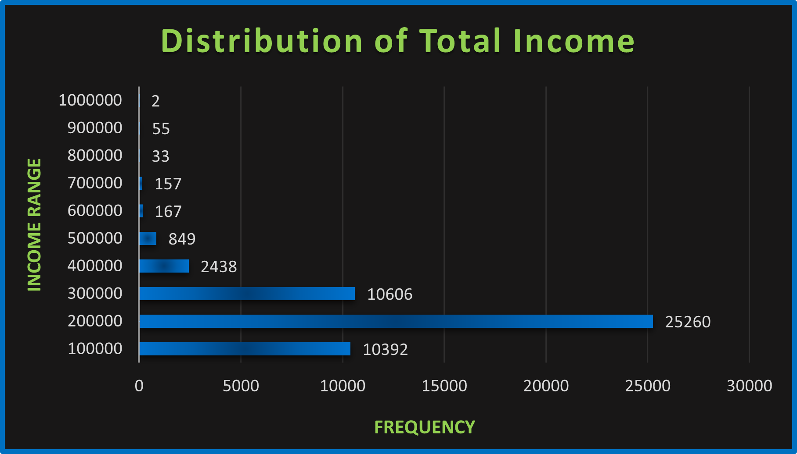
D. Perform Univariate, Segmented Univariate, and Bivariate Analysis: Perform univariate analysis to understand the distribution of individual variables, segmented univariate analysis to compare variable distributions for different scenarios, and bivariate analysis to explore relationships between variables and the target variable using Excel functions and features.
Univariate Analysis
AMT_INCOME_TOTAL :
Positively skewed (most values cluster on the lower end).
Majority of applicants fall in the 100,000 to 300,000 income range.
Very few applicants have income above 500,000 — indicating high-income values are outliers.

Slide 16
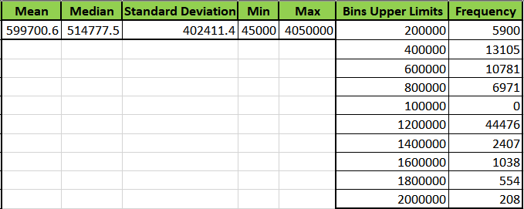
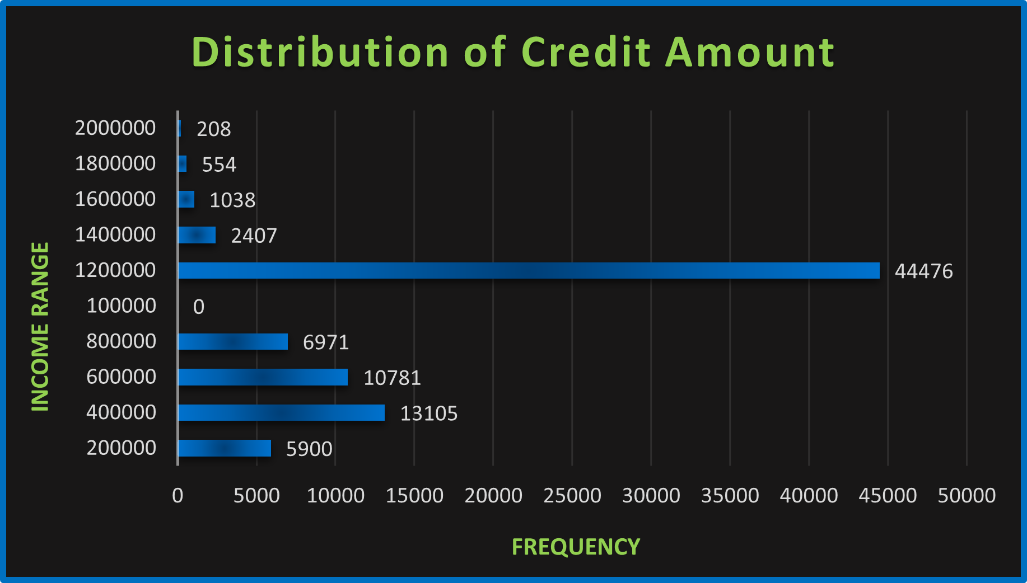
AMT_CREDIT :
Similar skewed pattern.
Most credit values are concentrated below 500,000.
A few applicants have very high credit limits above 800,000.

Slide 17
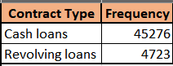
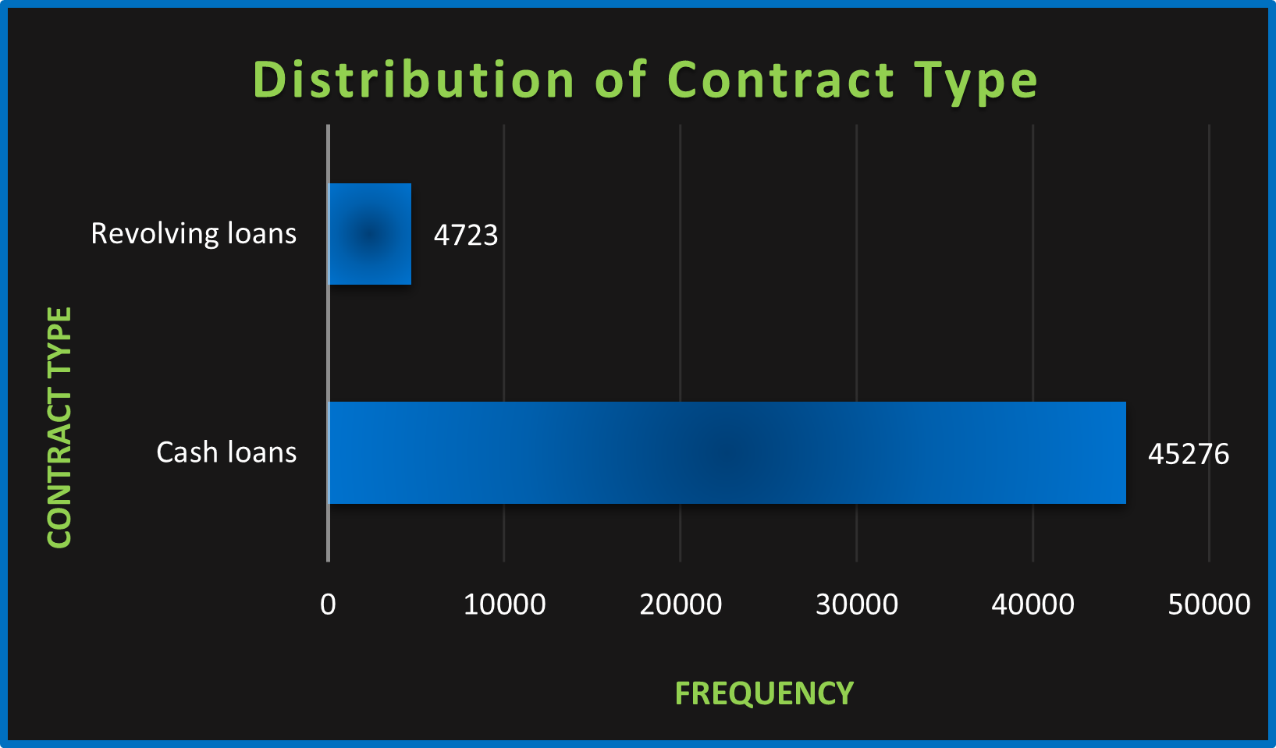
NAME_CONTRACT_TYPE :
Cash loans dominate by a large margin over revolving loans.
Shows a strong preference or need for lump-sum cash financing.

Slide 18
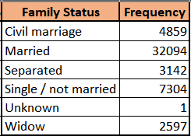
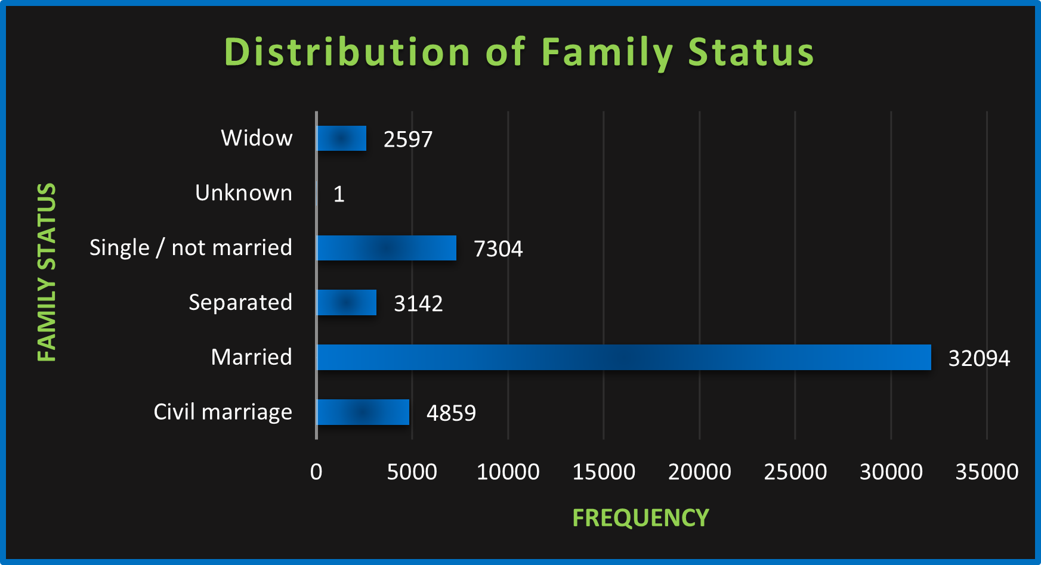
NAME_FAMILY_STATUS :
Married, Single / not married, and Civil marriage are the most frequent.
Majority of applicants are in stable family structures.
Minor categories like Widow or Separated are much smaller.

Slide 19
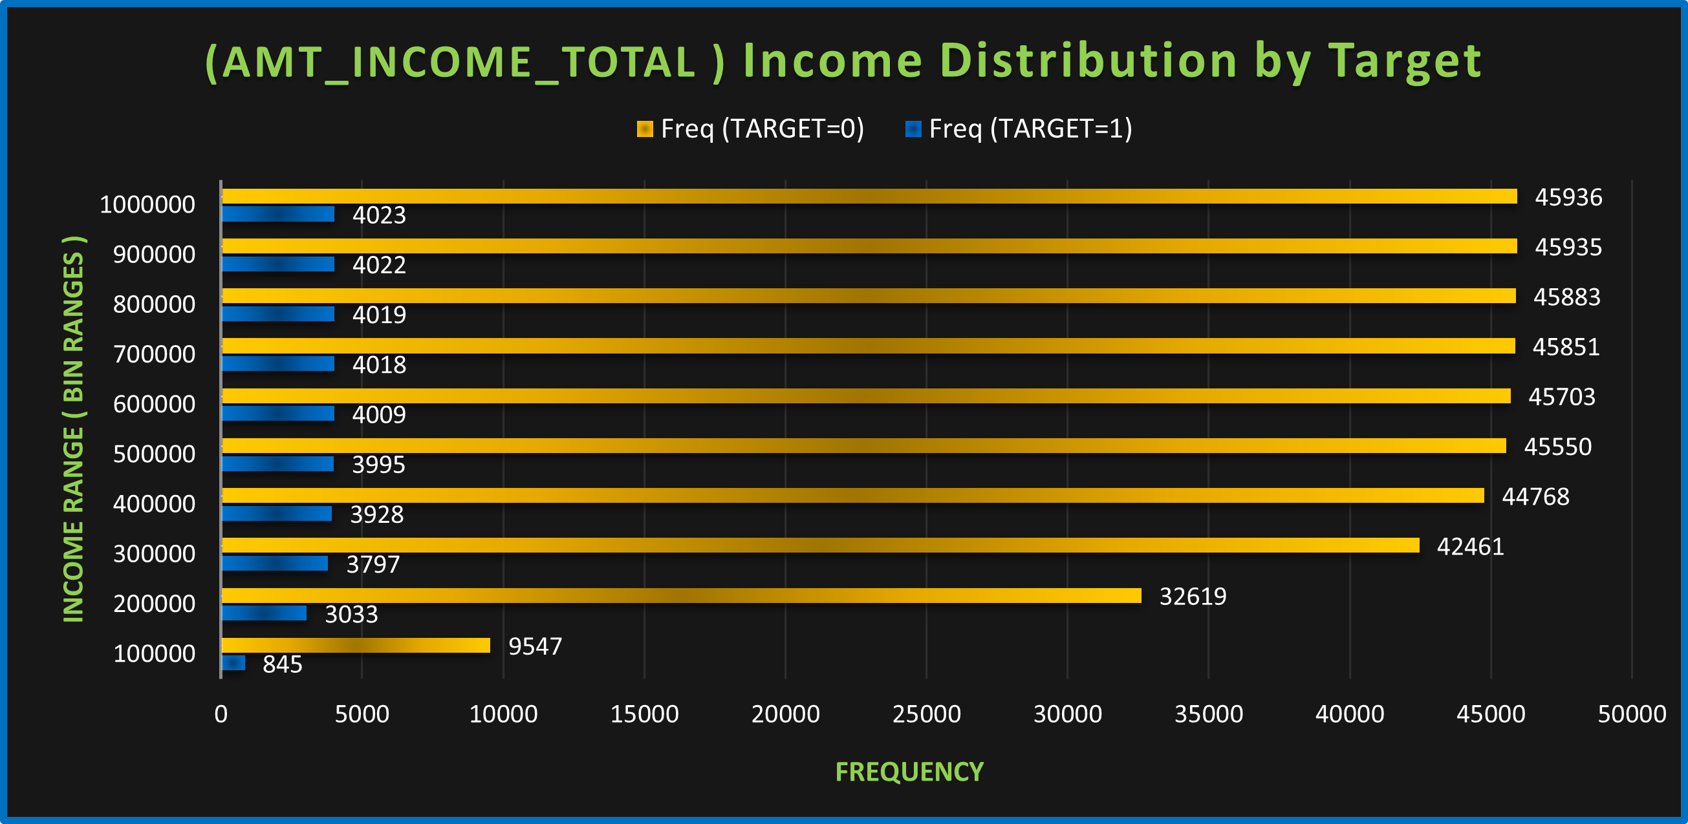
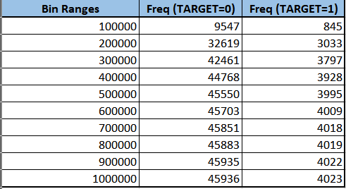
Segmented Univariate Analysis
Lower-income bins (≤ 200000)
A much higher proportion of defaulters fall in these bins compared with non-defaulters.
Middle-income bins (200000–500000)
Non-defaulters begin to dominate here, but there’s still a noticeable number of defaulters.
Higher-income bins (> 500000)
Defaulters almost vanish—non-defaulters overwhelmingly occupy the top income ranges.
Defaulters are concentrated among lower-income applicants, while higher-income applicants are very unlikely to default.

Slide 20
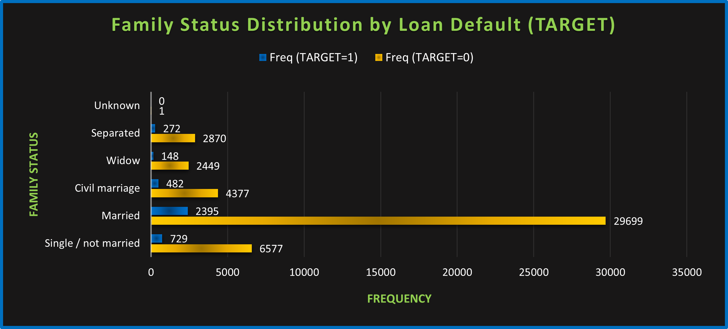
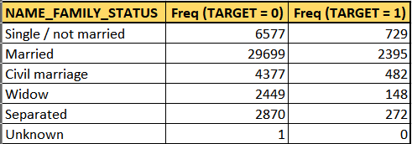
Single / not married
Shows the highest relative default rate (large defaulter bar compared to non-defaulter bar).
Married
Despite being the largest group, married applicants default at a lower rate.
Civil marriage, Separated, Widow
These smaller categories have mixed results, but generally show moderate to low default rates compared with singles.
Being single is associated with higher default probability; married status appears to be protective.

Slide 21
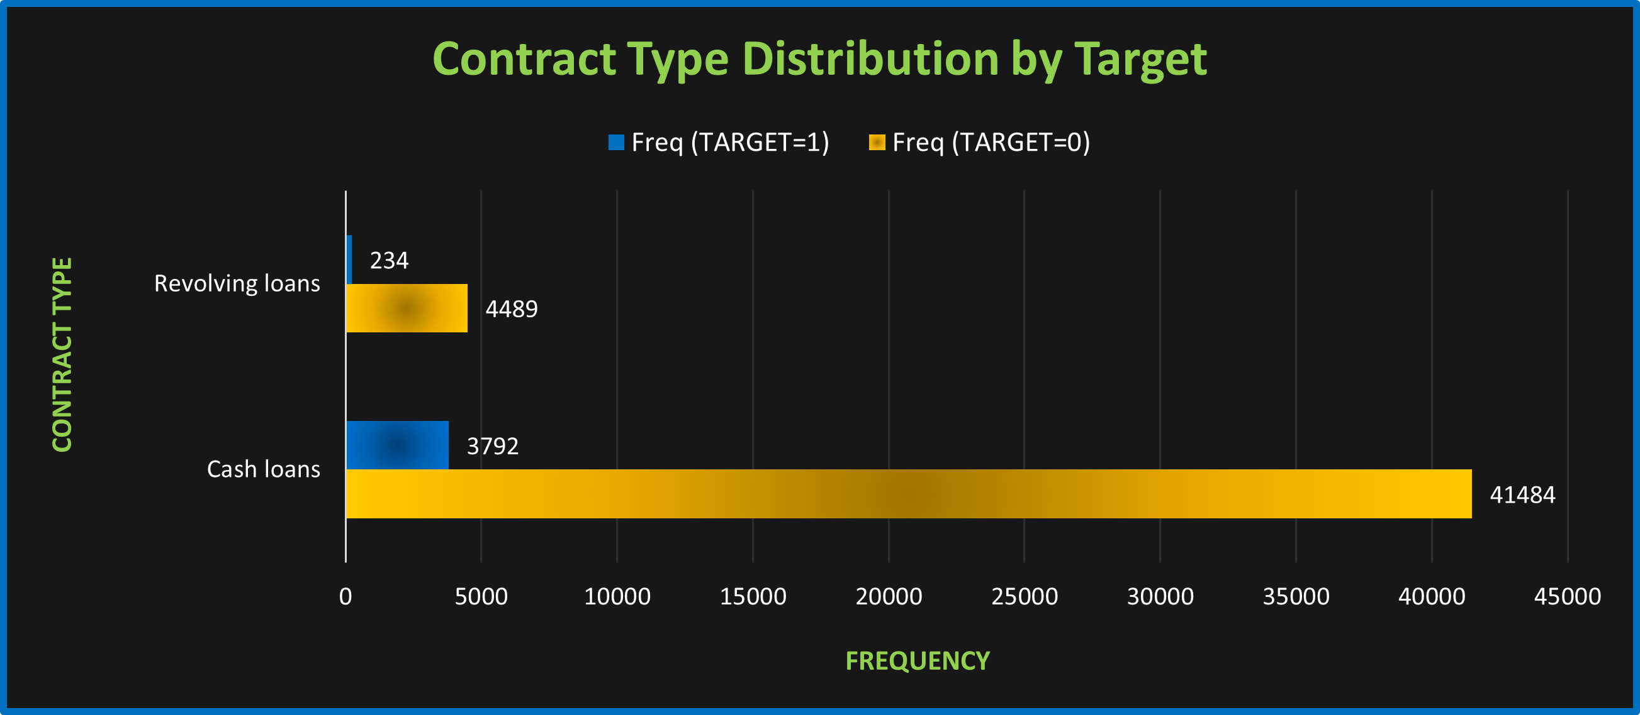
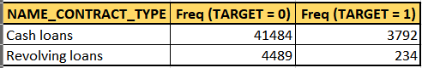
Cash loans
Though cash loans are the majority product, the default rate (height of the TARGET=1 bar relative to TARGET=0) is lower than for revolving loans.
Revolving loans
A higher proportion of revolving-loan applicants default compared with their cash-loan peers.
Revolving loans carry greater default risk than one-off cash loans in this dataset.

Slide 22
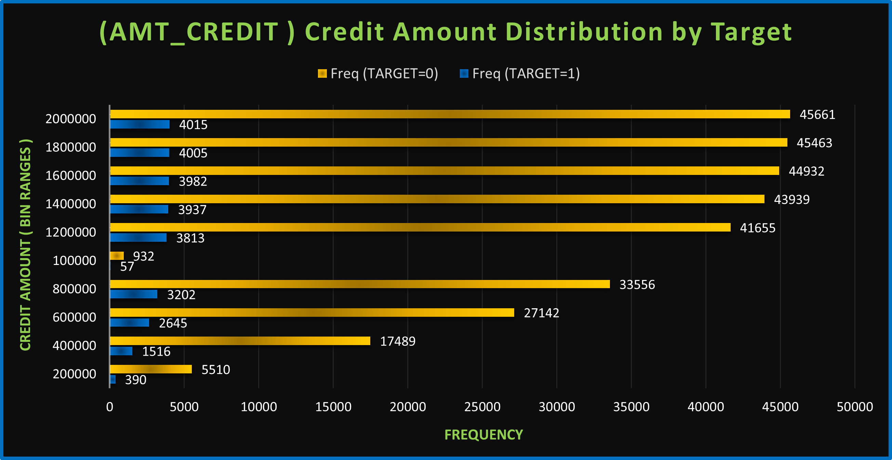
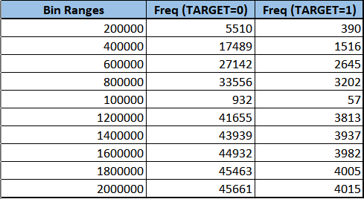
Low-credit bins (≤ 400000)
Defaulters comprise a significant share of this segment.
Medium-credit bins (400000–1000000)
The non-defaulter bars grow taller, but a non-trivial contingent of defaulters remains.
High-credit bins (> 1000000)
Defaults drop off sharply—most high-credit applicants do not default.
Defaults are skewed toward smaller‐loan sizes; larger loans tend to be repaid on time.

Slide 23
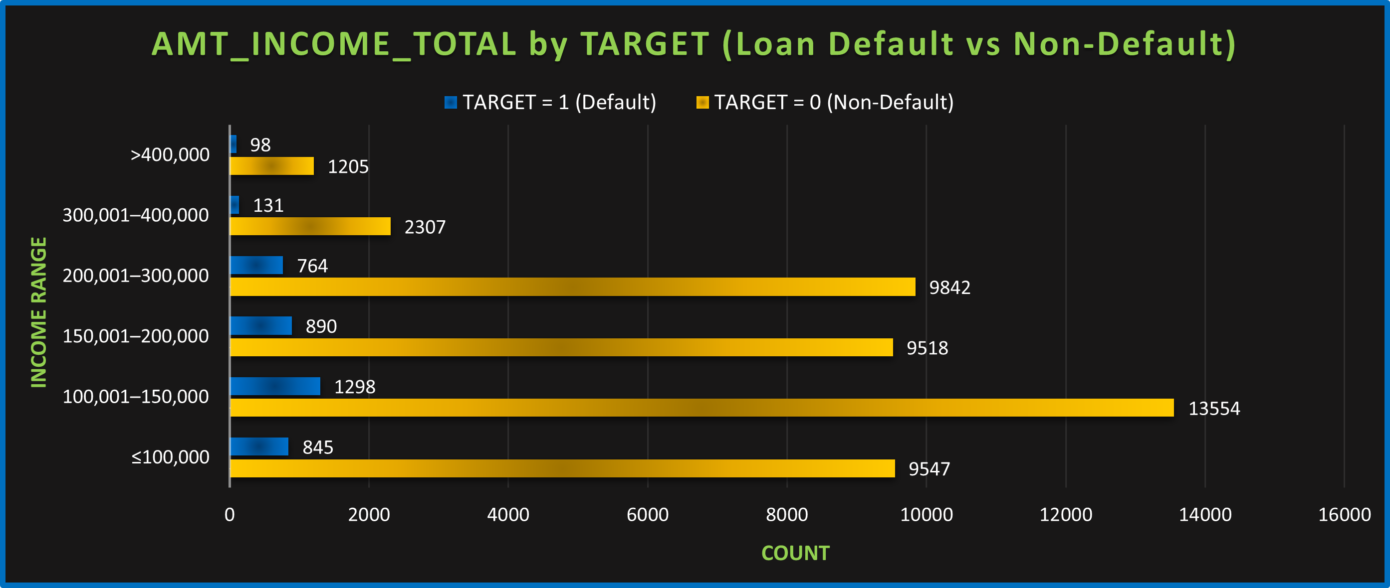
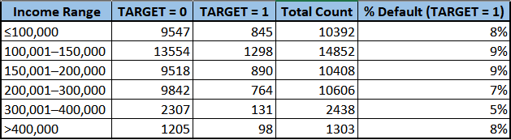
Bivariate Analysis
AMT_INCOME_TOTAL vs TARGET:
Applicants with income <=100000 or >100000 and <=200000 are more likely to default, while income >400000 and <=600000 or >600000 and <=1000000 might have fewer defaults.
TARGET = 0 and TARGET = 1 are calculated by formula: =COUNTIFS

Slide 24
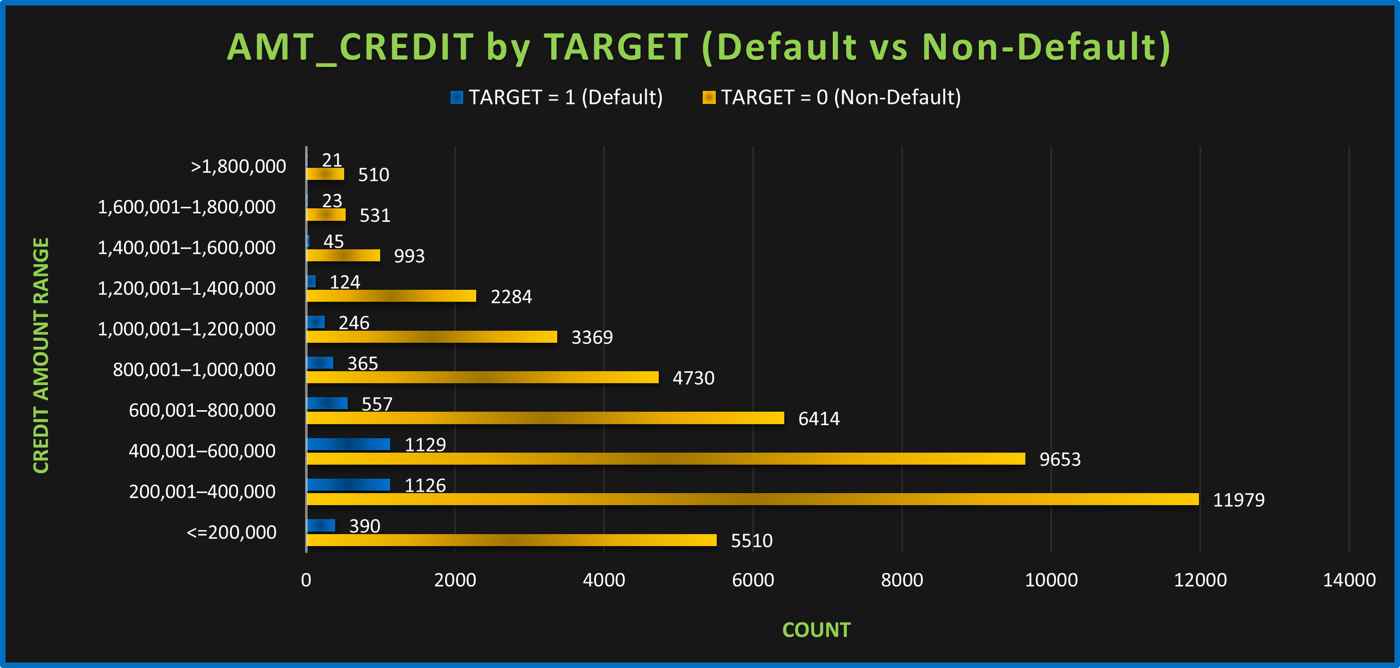
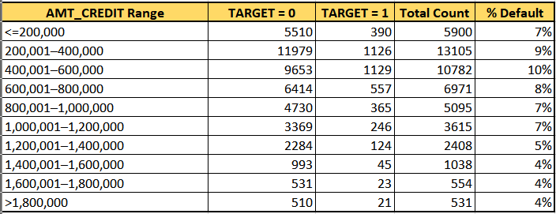
AMT_CREDIT vs TARGET:
It’s likely that larger credit amounts are associated with more defaults. For example, applicants with higher credit limits may have a higher risk of defaulting on their loans.

Slide 25
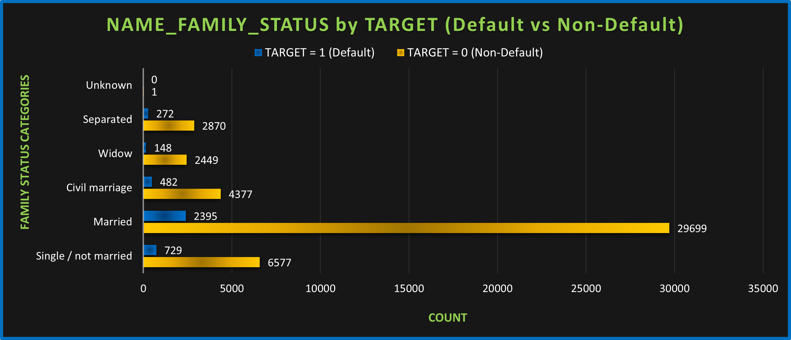
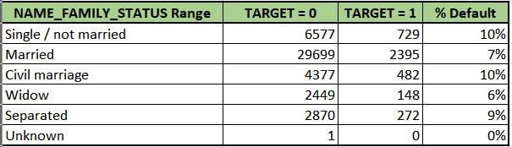
NAME_FAMILY_STATUS vs TARGET:
It could show that certain family statuses, such as "Single," might have a higher default rate compared to "Married" applicants, but the exact pattern will depend on the dataset's characteristics.

Slide 26
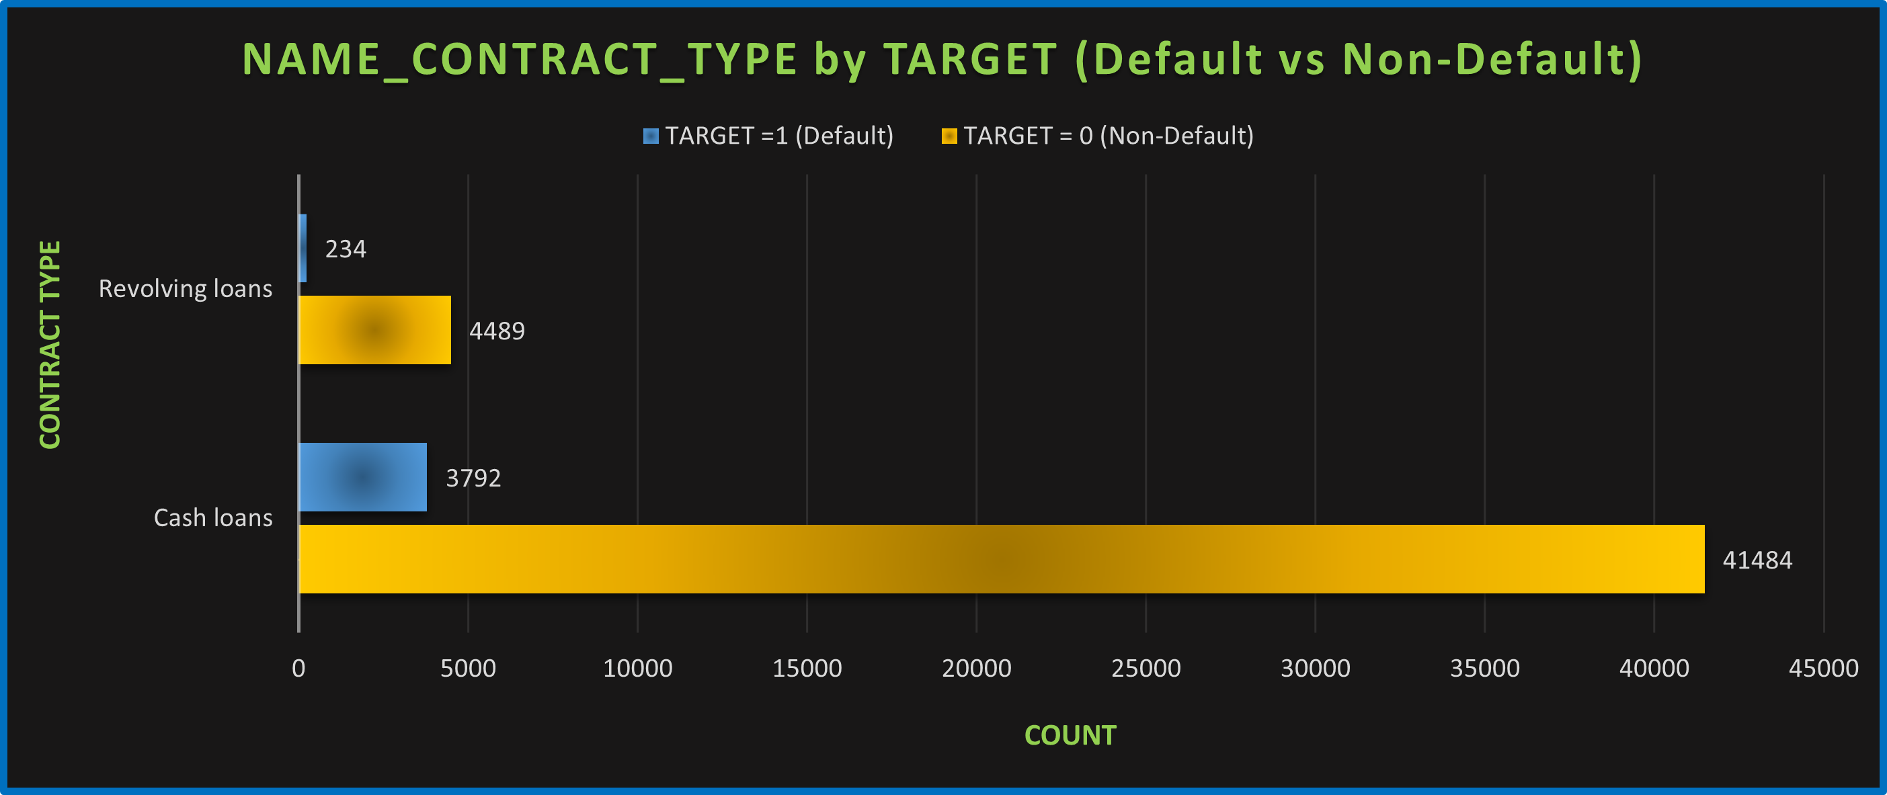
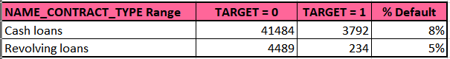
NAME_CONTRACT_TYPE vs TARGET:
Certain contract types, such as "Revolving loans," might show a higher default rate compared to "Cash loans." Revolving loans could have more flexible terms, which might make them riskier for defaults.

Slide 27
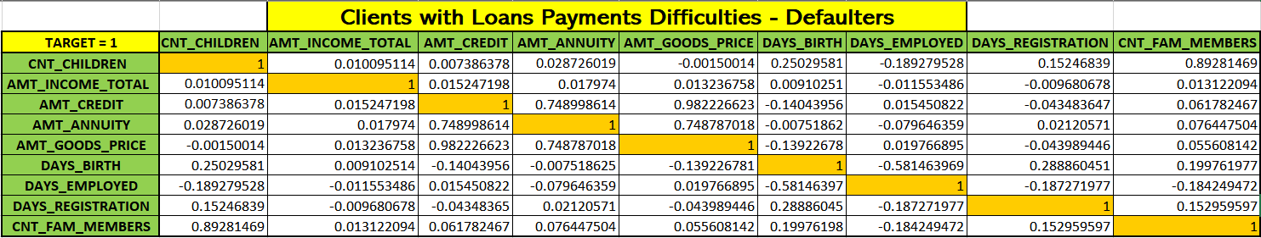
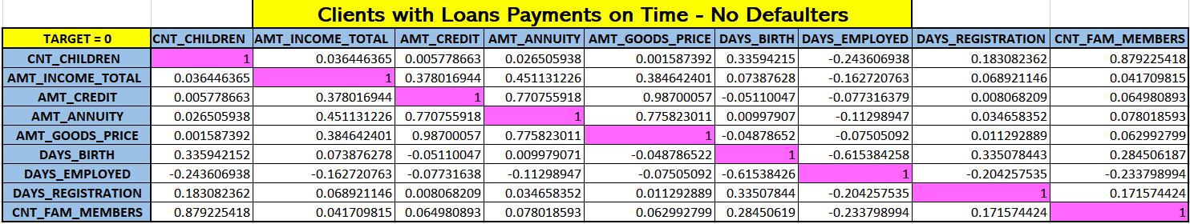
E. Identify Correlations: Segment the dataset based on different scenarios (e.g., clients with payment difficulties and all other cases) and identify the top correlations for each segmented data using Excel functions.

Slide 28
Strong Correlations in Both Groups:
CNT_CHILDREN and CNT_FAM_MEMBERS (~0.89): More children = more family members.
AMT_CREDIT and AMT_GOODS_PRICE (~0.98–0.99): Bigger loans are tied to more expensive goods.
AMT_CREDIT and AMT_ANNUITY (~0.75): Larger credit = higher monthly payments.
Differences Between Groups:
Non-Defaulters:
Older clients tend to be employed longer.
Employment days relate more to stability (negative correlation with age and registration days).
Defaulters:
Correlations with employment are weaker — suggesting unstable income or job history.
Income (AMT_INCOME_TOTAL):
Weakly correlated with most variables in both groups — not a strong predictor on its own.

Slide 29

Results & Conclusion
In this project, risk analytics was applied to a large bank loan dataset to identify key factors influencing defaults. After cleaning the data by handling missing values and outliers, it was found that only 8% of applicants were defaulters, indicating a highly imbalanced dataset. Key insights showed that single applicants, lower-income groups, and revolving loan holders had higher default rates, while married applicants and higher-income groups were more reliable borrowers. Strong correlations were observed between loan amounts, goods prices, and family size.
The study concluded that focusing on applicant stability, income level, family status, and loan type can help banks improve their loan approval strategies and reduce default risk.

Slide 30


